Slide 1
Chapter 38

Slide 2
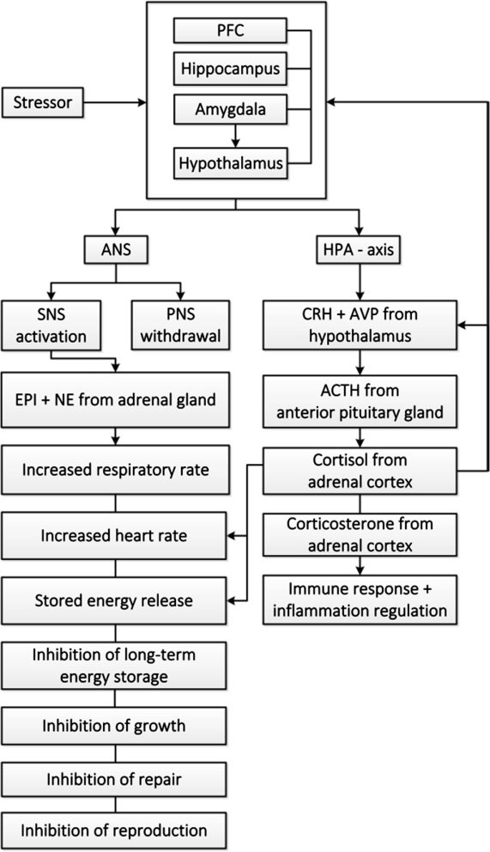
Figure 1 Overview of systems involved in stress response (allostasis). PFC, prefrontal cortex; ANS, autonomic nervous system; SNS, sympathetic nervous system; PNS, parasympathetic nervous system; EPI, epinephrine; NE, norepinephrine; HPA, hypothalamic-pituitary-adrenal; CRH, corticotropin-releasing hormone; AVP, arginine vasopressin; ACTH, adrenocorticotropic hormone.
Adapted from Refs. 8,20–22.

Slide 3
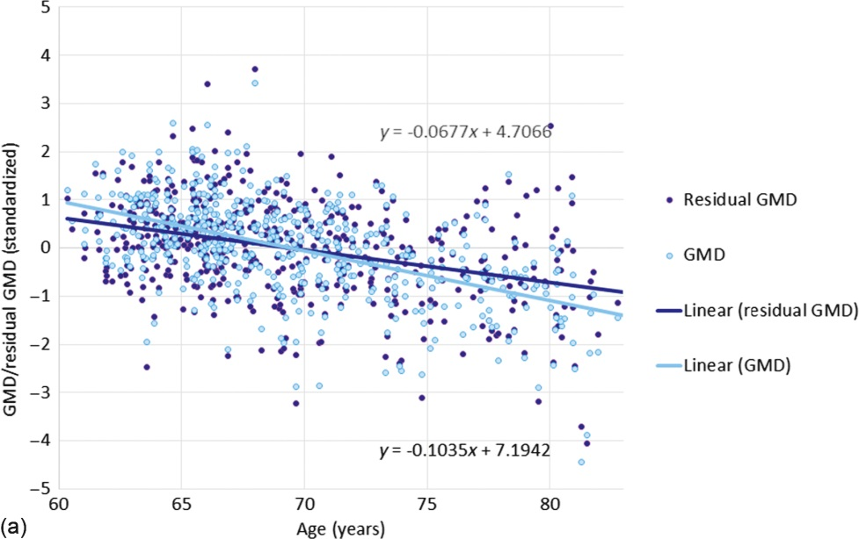
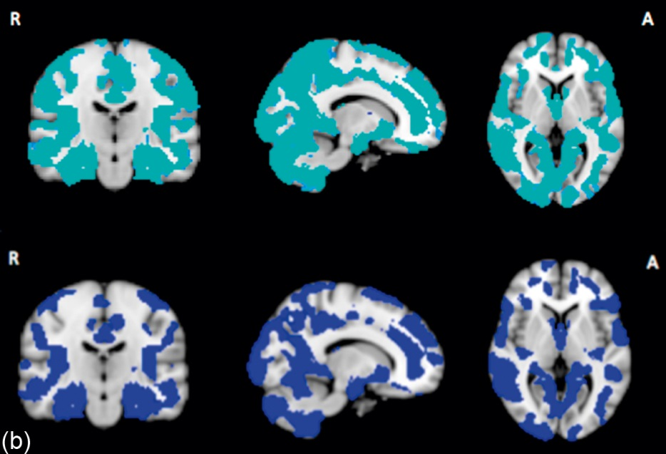
Figure 2 Association between age and average gray matter density (GMD). (a) Before-and-after controlling for vascular risk [measured by % Framingham Stroke Risk Score (FSRS)] in a sample of community-dwelling adults (N = 527, age = 69.5 ± 5.29 years, 421 male).⁶⁶ The change in regression slope was significant, leaving a regression slope after controlling for % Framingham Risk Score that remained significant (i.e., Framingham Risk Score partially accounts for age effect). (b) Images were analyzed with FSL-VBM and optimized voxel-based morphometry (VBM) protocol. Using randomize and correcting for multiple comparisons, voxelwise general linear model (GLM) was applied between age and GM (top image), and age and GM with FSRS as confounder (bottom image). Significance threshold was set at p < 0.05 using threshold-free cluster-enhancement (tfce). Extracted standardized average gray matter densities (residuals) are shown in the plot.

